Slide 1

Dr .Mahalingam College of Engineering & Technology
Department of Computer Science and Engineering 19CSPN6401 & Mini - Project
Final Review
Title : IOT BASED MOBILE APPLICATION FOR FINGERPRINT DOOR
LOCK SYSTEM
Domain: Internet of Things
Team Number: B007
Team Member(s): SELVA ADHITHIYAN .P – 727621BCS006
RANJITHKUMAR .K – 727621BCS012
KARTHICK .M – 727621BCS100
Project Guide: Ms . BHARATHI AP/CSE
Date: 18.5.2023

Slide 2
Contents
Domain Introduction
Problem description/Statement
Abstract
Literature survey
Objective of the Project
Existing System
Drawbacks of Existing System
Proposed System
Advantages of Proposed System
Block Diagram of Proposed System
Hardware / Software Requirements
Components
Modules
Conclusion and Future Enhancements
Reference(s)
Certificates(Online Course)
Certificates(Paper Presentation)
Online course details Progress / Completion

Slide 3
Domain Introduction
The Internet of Things (IoT) is an ecosystem of connected devices that communicate and exchange data with each other.
In this project we propose a smart locking system which is designed to work based on the Internet of Things to prevent unauthorized access and trespassing
Fingerprint acknowledgment is one of the most secure systems in light of the fact that a fingerprint of one individual never coordinates with the others.
Hence, unapproved access can be restricted by arranging a lock that stores the fingerprints of at least one approved individual and opens the lock when a match is found.

Slide 4
Problem description
The main aim of our project is to provide a user to remotely unlock the door.
The problem statement for our project is to create a secure and convenient access control system.
Going to build a Biometric Lock using Arduino Nano with Bluetooth Module, Solenoid Lock, and Android Phone.
Apart from hardware, a mobile application is also used to scan and verify the fingerprint and send the confirmation ID to Arduino through Bluetooth .
Here we will use Smart Phone Finger Print Sensor to lock and unlock the door lock.

Slide 5
Abstract
Conceptual Security has consistently been a significant worry to the general public either in the family units or the workplace condition. There are different methodologies set up to address these issues.
This venture is proposed to build up a smart locking framework utilizing the Internet of Things. Utilizing conventional keyed locks is basic since the start of humankind, anyway there is a high risk of keys being lost or getting into inappropriate hands.
Subsequently, many individuals prefer biometric locks over traditional keyed locks to improve the security of their homes or workplaces.
In contrast to the conventional lock, a cutting-edge biometric lock requires no key to bolt or open the door and instead uses a biometric sensor.
Key Words: Arduino Nano, Biometric Sensor, framework, smartphone, relay
module

Slide 6
Literature survey
"Development of a Fingerprint Door Lock System Using Arduino and Bluetooth" by A. O. Afolabi et al. (2021): In this study, the authors designed and implemented a fingerprint door lock system using Arduino and Bluetooth. The system uses a fingerprint sensor to authenticate users and Bluetooth module to communicate with a smartphone. The authors reported that the system provides high-level security and convenience to users.
"Smartphone-Based Access Control System for Smart Homes" by M. A. Al-Khaffaf et al. (2021): In this study, the authors proposed a smartphone-based access control system for smart homes. The system uses an Arduino microcontroller to control the door lock and a smartphone app to communicate with the Arduino through Wi-Fi. The authors reported that the system provides a high level of security and convenience to users.
Mishra, S. and Srivastava, A. (2020). “Fingerprint Recognition Door Locking System Based on Arduino”. International Journal of Emerging Trends in Engineering Research, 8(1), 567-572.

Slide 7
"Design and Implementation of a Fingerprint Based Door Lock System Using Arduino and Wi-Fi" by M. N. Islam et al. (2020): In this study, the authors designed and implemented a fingerprint-based door lock system using Arduino and Wi-Fi. The system uses a fingerprint sensor to authenticate users and Wi-Fi module to communicate with a smartphone app. The authors reported that the system provides a high level of security and convenience to users.
"Smart Lock System Based on IoT" by S. S. Thakur et al. (2020): In this study, the authors proposed a smart lock system based on IoT. The system uses an Arduino microcontroller to control the lock and smartphone app to communicate with the microcontroller,as reported in their study.
Priyadarshini, P., & Panda, S. (2018). “Design and Implementation of Biometric Lock System Using Arduino”. International Journal of Emerging Trends in Engineering Research,

Slide 8
Objective
Our main objective is to prevent ,where unauthorized access takes place are Banks, Financial organization, Government offices and organization, and shops.
Assurance of safety to the users for their property.
ADVANTAGES:
It is secure.
No requirement for keys .
Efficient

Slide 9
Existing System
The Fingerprint-Based Door Lock System is a project that involves creating a secure door lock system using an Arduino Nano, Bluetooth module, fingerprint sensor module, and relay module.
The system is designed to identify authorized users by scanning their fingerprints using the fingerprint sensor module.
The fingerprint sensor module is connected to the Arduino Nano, which processes the input and determines if the scanned fingerprint is registered as an authorized user. If the fingerprint matches, the Arduino Nano sends a signal to the Bluetooth module, which then communicates with the user's smartphone via Bluetooth to unlock the door.

Slide 10
Drawbacks Existing System
Security Concerns: While fingerprint sensors are generally considered more secure than traditional keys or passwords, they are not foolproof. Some fingerprint sensors can be hacked or fooled using fake fingerprints. Therefore, it's important to ensure that the fingerprint sensor used in the system is reliable and secure.
Integration: There’s no consensus regarding IoT protocols and standards, so devices produced by different manufacturers may not work well together. The lack of uniformity prevents full-scale integration of IoT, therefore limiting its potential effectiveness.
Cost: The cost of the components required to build the system may be higher than that of traditional lock systems. This may be a barrier for some users who are on a budget.
Safety Alarm: There is no alarm Sound to users when unrecognized fingerprint tries to access the door. This leads to insecure for people.

Slide 11
Proposed System
The fingerprint door lock system described here uses Bluetooth, an Arduino Nano microcontroller, a relay module, a smartphone, an LED, and a buzzer to provide secure access control without the use of a fingerprint sensor. Instead of scanning fingerprints, the system works by pairing the user's smartphone with the Bluetooth module on the Arduino.
When the user's smartphone is within range, the Arduino Nano detects the Bluetooth signal and activates the relay module, which in turn unlocks the door. The LED and buzzer provide feedback to the user, indicating whether the door is locked or unlocked. To set up the system, the user needs to install a smartphone app that communicates with the Arduino via Bluetooth. The app allows the user to pair their phone with the Arduino and control the lock.
This system provides a convenient and secure way to control access to a door without the need for physical keys or biometric Sensors.

Slide 12
Advantages of Proposed System
Cost-effective: Arduino Nano is a relatively inexpensive microcontroller board, making it an affordable solution for creating a custom door lock system. There is no use of fingerprint Sensor. Including Fingerprint Sensor may result in large investment in cost.
Flexibility: With an Arduino Nano, it is possible to program and customize the lock's behavior to meet specific needs. For example, the lock can be set to automatically lock after a certain period of time or only allow access during specific hours of the day.
Visual and audible feedback: An LED and buzzer can be used to provide visual and audible feedback to the user, indicating whether the door has been successfully unlocked or not.
Convenience: With a Bluetooth-enabled device, such as a smartphone, users can easily unlock the door without needing to carry a key or remember a combination code.
Security: The relay module is used to control the lock mechanism. When the Arduino Nano receives the signal that the user has been authenticated, it sends a signal to the relay module to unlock the door. This system provides an added layer of security since it requires a registered fingerprint to unlock the door.

Slide 13
Block Diagram of Proposed System
POWER SUPPLY BOARD
ARDUINO
NANO
.
LED
BUZZER
HC-05
BLUETOOTH
MODULE
SOLENOID LOCK
RELAY MODULE

Slide 14
Hardware / Software Requirements
Hardware Requirements:
Arduino Nano
Bluetooth Module (HC05)
Relay Module
Solenoid Lock
Buzzer
LED
Jumper Wires
Power supply board
Software Requirements:
Kodular
Arduino IDE

Slide 15
Components
Arduino Nano :Arduino Nano is a small-sized microcontroller board based on the ATmega328P chip. It has a compact form factor and is compatible with breadboards, making it easy to integrate into various projects. The Nano has 14 digital input/output pins, 8 analog pins, and a 16 MHz clock speed. The board has a USB interface for programming and power, as well as an on-board voltage regulator for stable operation
Relay Module :A relay module is an electronic device that allows low-power circuits to control high-power circuits using an electromagnetic switch. A 12V relay module operates using a 12V DC power supply and can handle up to 10A current load.
Bluetooth Module :The HC-05 Bluetooth module is a wireless communication device that allows for easy Bluetooth connectivity between microcontrollers and other devicesIt supports baud rates from 1.2 Kbps to 138 Kbps, and a range of up to 10 meters. The module has a built-in antenna and operates at 3.3V.It can be used with various microcontrollers, such as Arduino, Raspberry Pi .

Slide 16
Components
Solenoid Lock : A solenoid lock is an electrically controlled lock that uses a solenoid to control the locking mechanism. Solenoid locks are commonly used in access control systems ,such as door locks and cabinet locks.
Arduino Ide : The Arduino IDE (Integrated Development Environment) is a software application used to write and upload code to Arduino microcontroller boards.It is a free and open-source software that can run on Windows, macOS, and Linux operating systems. .It supports various programming languages, including C and C++, and comes with a library of pre-built functions for programming the boards.
Kodular : It is a free and open-source web-based platform for building mobile applications without coding . It uses a block-based visual programming language that allows users to drag and drop components to create mobile apps.The platform supports various components such as buttons, text boxes, lists, and images.It also has features for connecting to APIs, storing data, and creating dynamic app content

Slide 17
Modules
Kodular platform is used to develop an mobile application

Slide 18
Modules
Connect the Mobile Bluetooth to Bluetooth Module

Slide 19
Modules
Accessing with Recognized and Un-Recognized Fingerprint

Slide 20
Modules
Code Blocks for Desired Mobile Application

Slide 21
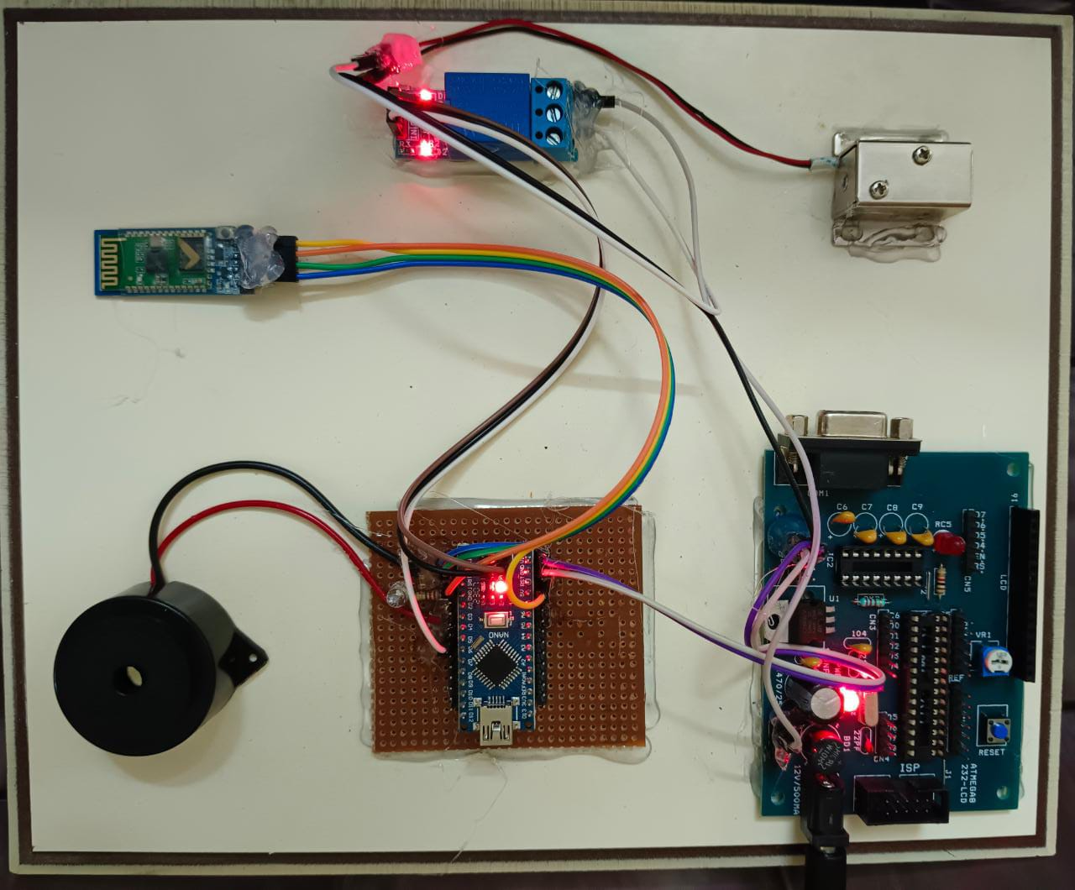
Modules
HARDWARE SETUP

Slide 22
Conclusion and future Enhancement
Conclusion:
To eliminate the need for human effort in operating door locks and is particularly useful in remote areas. “Smart Door Lock” demonstrates the potential of IoT and wireless communication in improving automation and security in everyday life. By automating the operation of door locks, it can enhance convenience while also providing an additional level of security to users. The successful completion of this project indicates the viability of using solenoid locks, Bluetooth, and biometric technology to create innovative and effective security solutions.

Slide 23
Conclusion and future Enhancement
Future Enhancement:
In the future, there are several enhancements that could be made to the Biometric lock project. One improvement would be to add a camera module to the system, which could take a picture of the person attempting to gain access. This would further increase security and provide a visual record of who entered and exited the room. Another enhancement could be to integrate the system with a home automation platform, allowing the lock to be controlled remotely via a smartphone or voice assistant. Additionally, the system could be improved by adding a backup power supply, such as a rechargeable battery, to ensure that the lock remains operational in the event of a power outage. Finally, the project could be expanded to include multiple doors or access points, allowing for greater control over who is allowed to enter different areas of a building. Overall, these enhancements would further increase the functionality and security of the Biometric lock system, making it an even more valuable tool for home and business owners

Slide 24
References
Arpita Mishra, Siddharth Sharma, Sachin Dubey, S.K.Dubey, “Password Based Security Lock System”,International Journal of Advanced Technology in Engineering and Science, 2011.
Bhalekar Pandurang, Jamgaonkar Dhanesh, Prof.Mrs. Shailaja Pede, Ghangale Akshay, Garge Rahul,“Smart Lock: A Locking System Using Bluetooth Technology & Camera Verification”, International Journal of Technical Research, 2013.
Lia Kamelia, Alfin Noor hassan S.R, Mada Sanjaya and W.S., Edi Mulyana “Door-Automation System Using Bluetooth-Based Android For Mobile Phone”, ARPN Journal of Engineering and Applied Sciences(ISSN 1819-6608), Vol. 9, No. 10, October 2014.

Slide 25
Neelam Majgaonkar, RuhinaHodekar, Priyanka Bandagale, “Automatic Door Locking System”,International Journal of Engineering Development and Research, Volume 4, Issue 1,2013 ISSN: 2321-9939.
R.A. Ramlee, D. H. Z. Tang, M.M.Ismail, “Smart Home System for Disabled People Via Wireless Bluetooth”, in Proc. of IEEE International Conference on System Engineering and Technology, pp. 1-4,2012.
Website link
https://iotdesignpro.com/projects/fingerprint-door-lock-system-using-arduino-and-smartphone

Slide 26
CERTIFICATES (ONLINE COURSE)

Slide 27
CERTIFICATES (ONLINE COURSE)

Slide 28
CERTIFICATES (ONLINE COURSE)

Slide 29
CERTIFICATES (PAPER PRESENTATION)

Slide 30
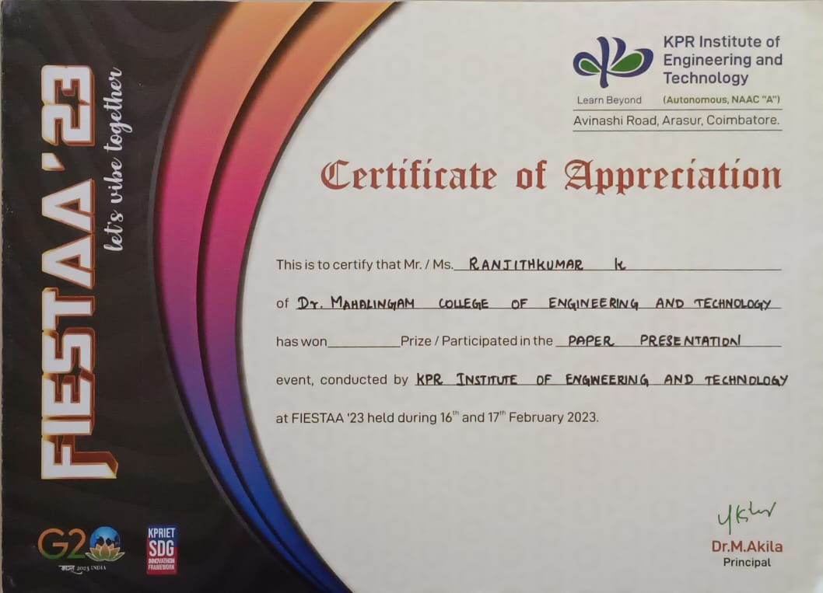
CERTIFICATES (PAPER PRESENTATION)

Slide 31
Online course details
Name of the Student | Course Title with Duration | Course Platform | Status
KARTHICK.M | AI AND BIG DATA IN IOT 4 WEEKS | GREAT LEARNING | Enrolled
RANJITHKUMAR.K | AI AND BIG DATA IN IOT 4 WEEKS | GREAT LEARNING | Enrolled
SELVA ADHITHIYAN. P | LEARN INTERNET OF THINGS ON CLOUD 4 WEEKS | GREAT LEARNING | Enrolled
31
31

